Slide 1

Parallel Sparse Matrix Solver for Circuit Simulations using FPGA
Yogesh Mahajan
Supervisor: Prof. Sachin Patkar
Electrical Engineering, IIT Bombay
October 2018

Slide 2
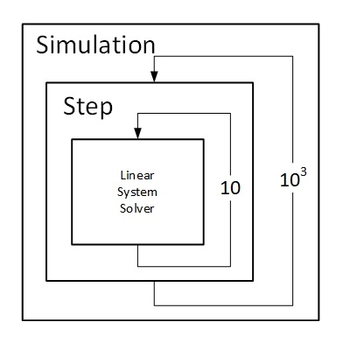
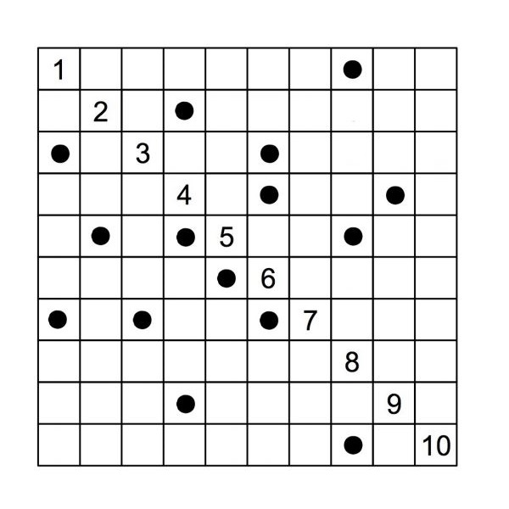
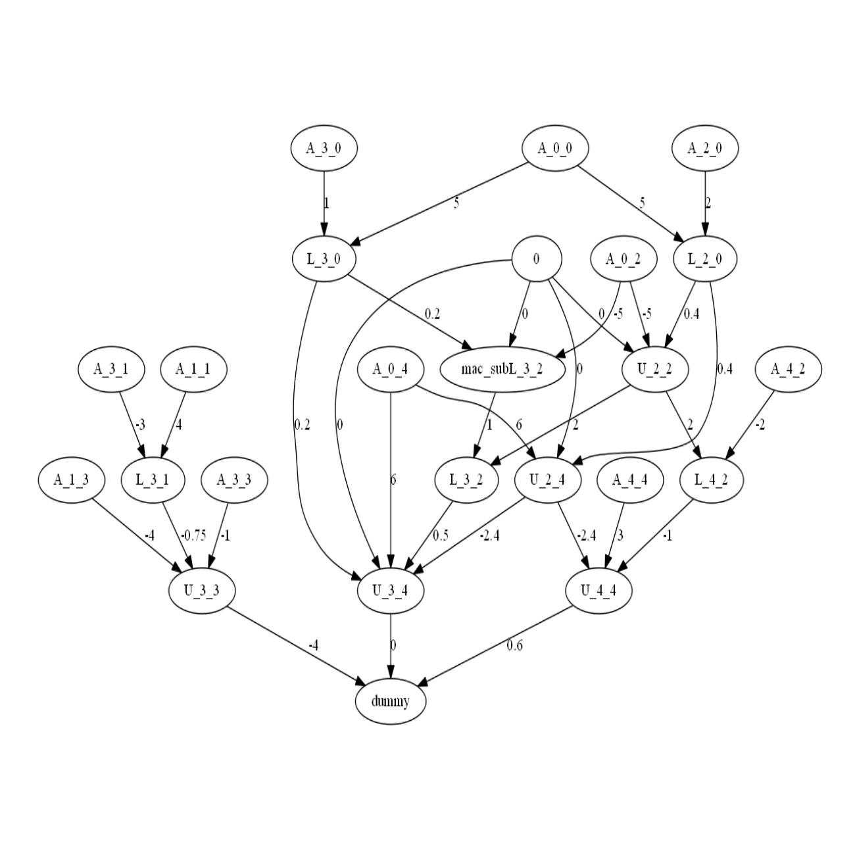
Motivation
Why and How to Accelerate Circuit Simulations?
Simulation requires several thousand repeated solution of the network matrix
Structure of matrix remains the same in each iteration
Data manipulation can be modelled using a task graph to extract parallelism

Slide 3
Parallelizing the Sparse LU Decomposition
Pre-processing
1
Symbolic Analysis
2
Pre-processing
Pre-processing
Convert matrix to sparse storage format
Pre-order the matrix for fill in reduction
Generate verification data
Find the non-zero location in factors
Generate the computation flow graph
Assign priority to each operation
Scheduling
3
Numeric Computation
4
Pre-processing
Pre-processing
Generate memory map
Generate priority list based schedule for the computation flow graph
Copy matrix data to FPGA
Execute using the predefined schedule
Write results back to main memory

Slide 4
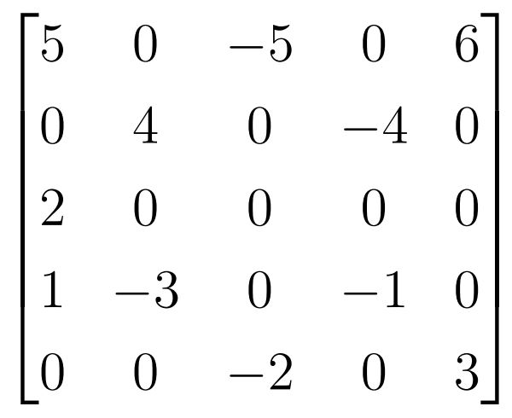
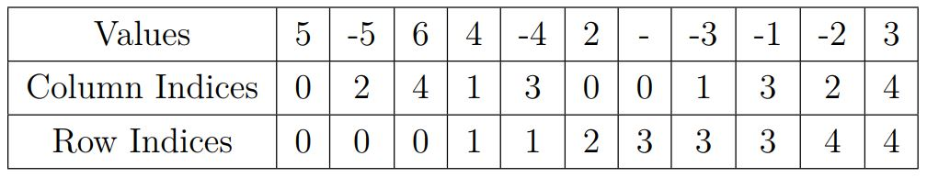
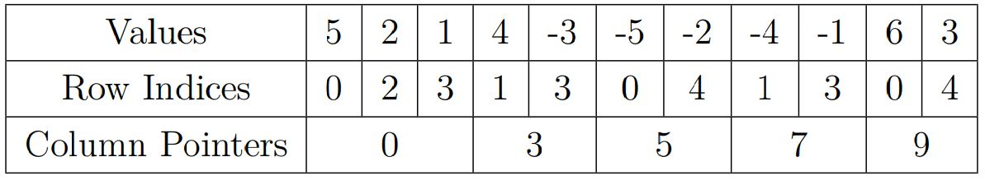
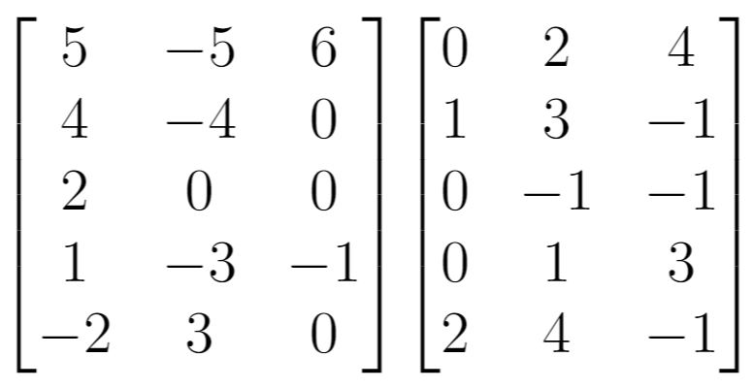
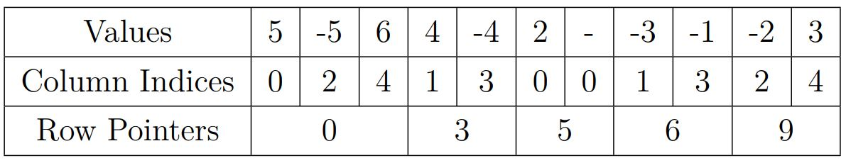
Sparse Matrix Storage Formats
Pre-Processing
Triplet Format
Sparse Matrix
Compressed Column Format
ELLPACK
Compressed Row Format

Slide 5
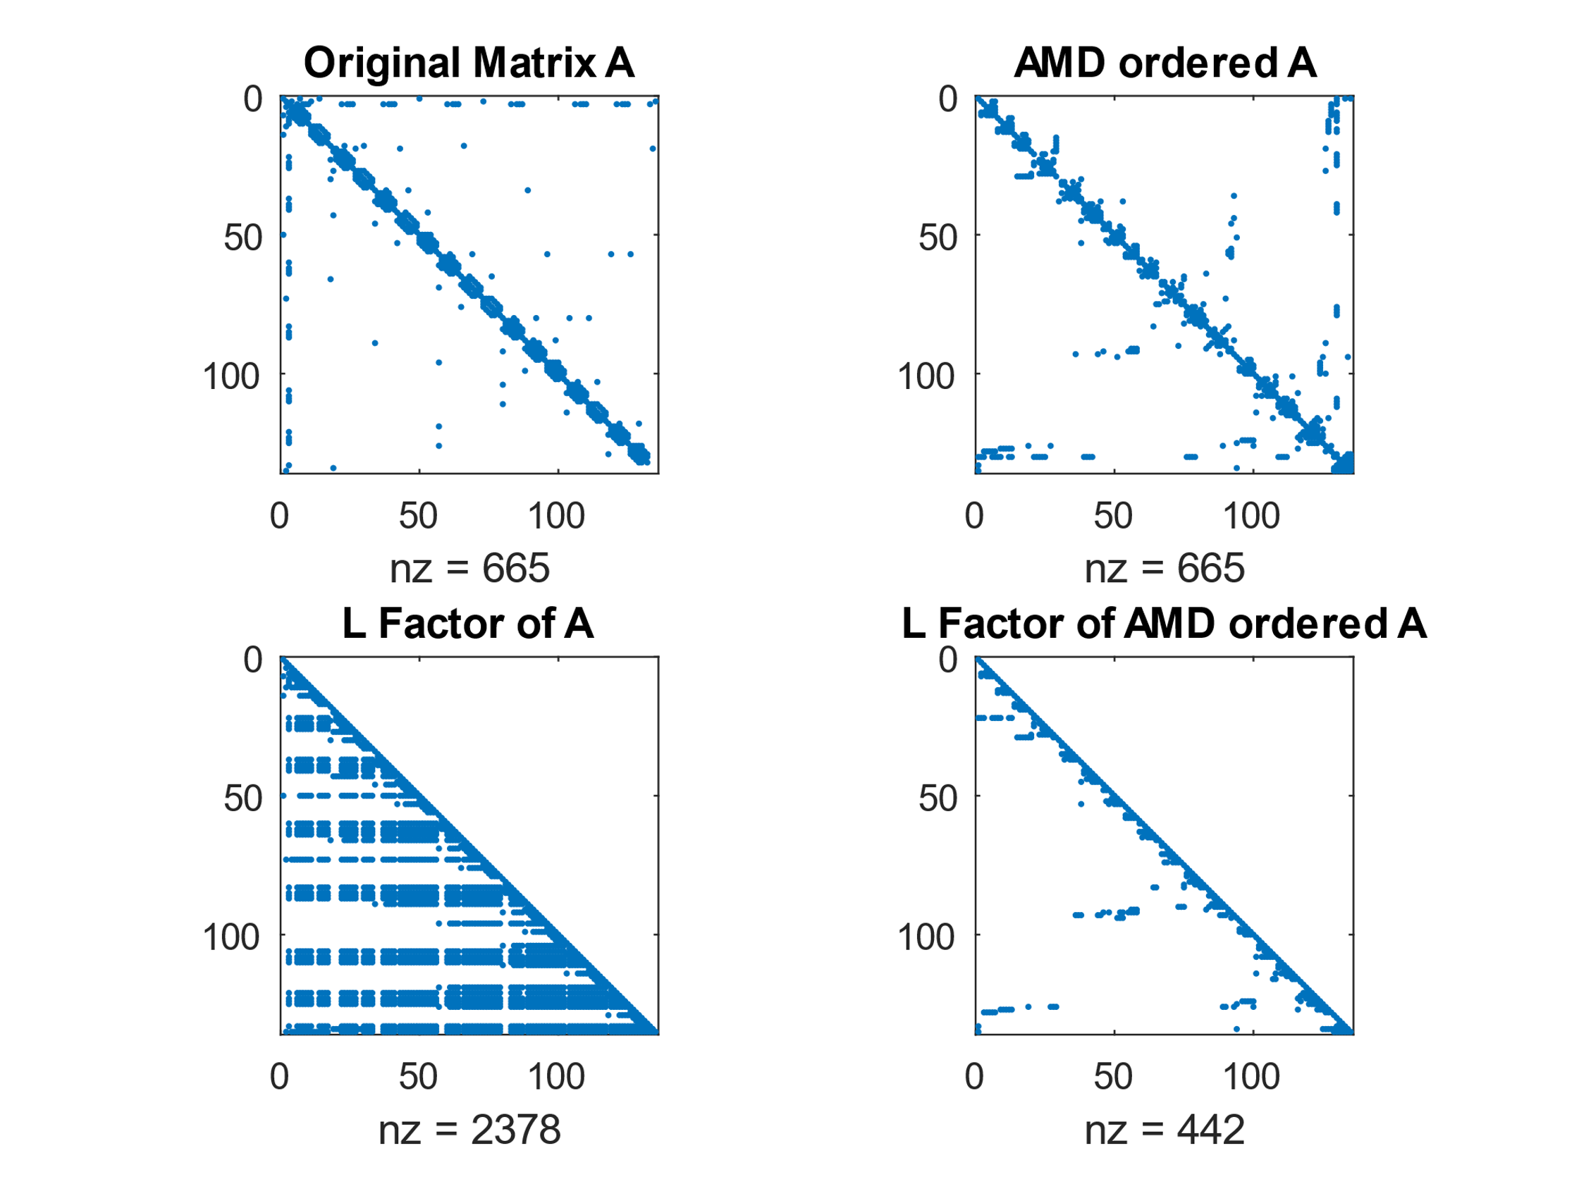
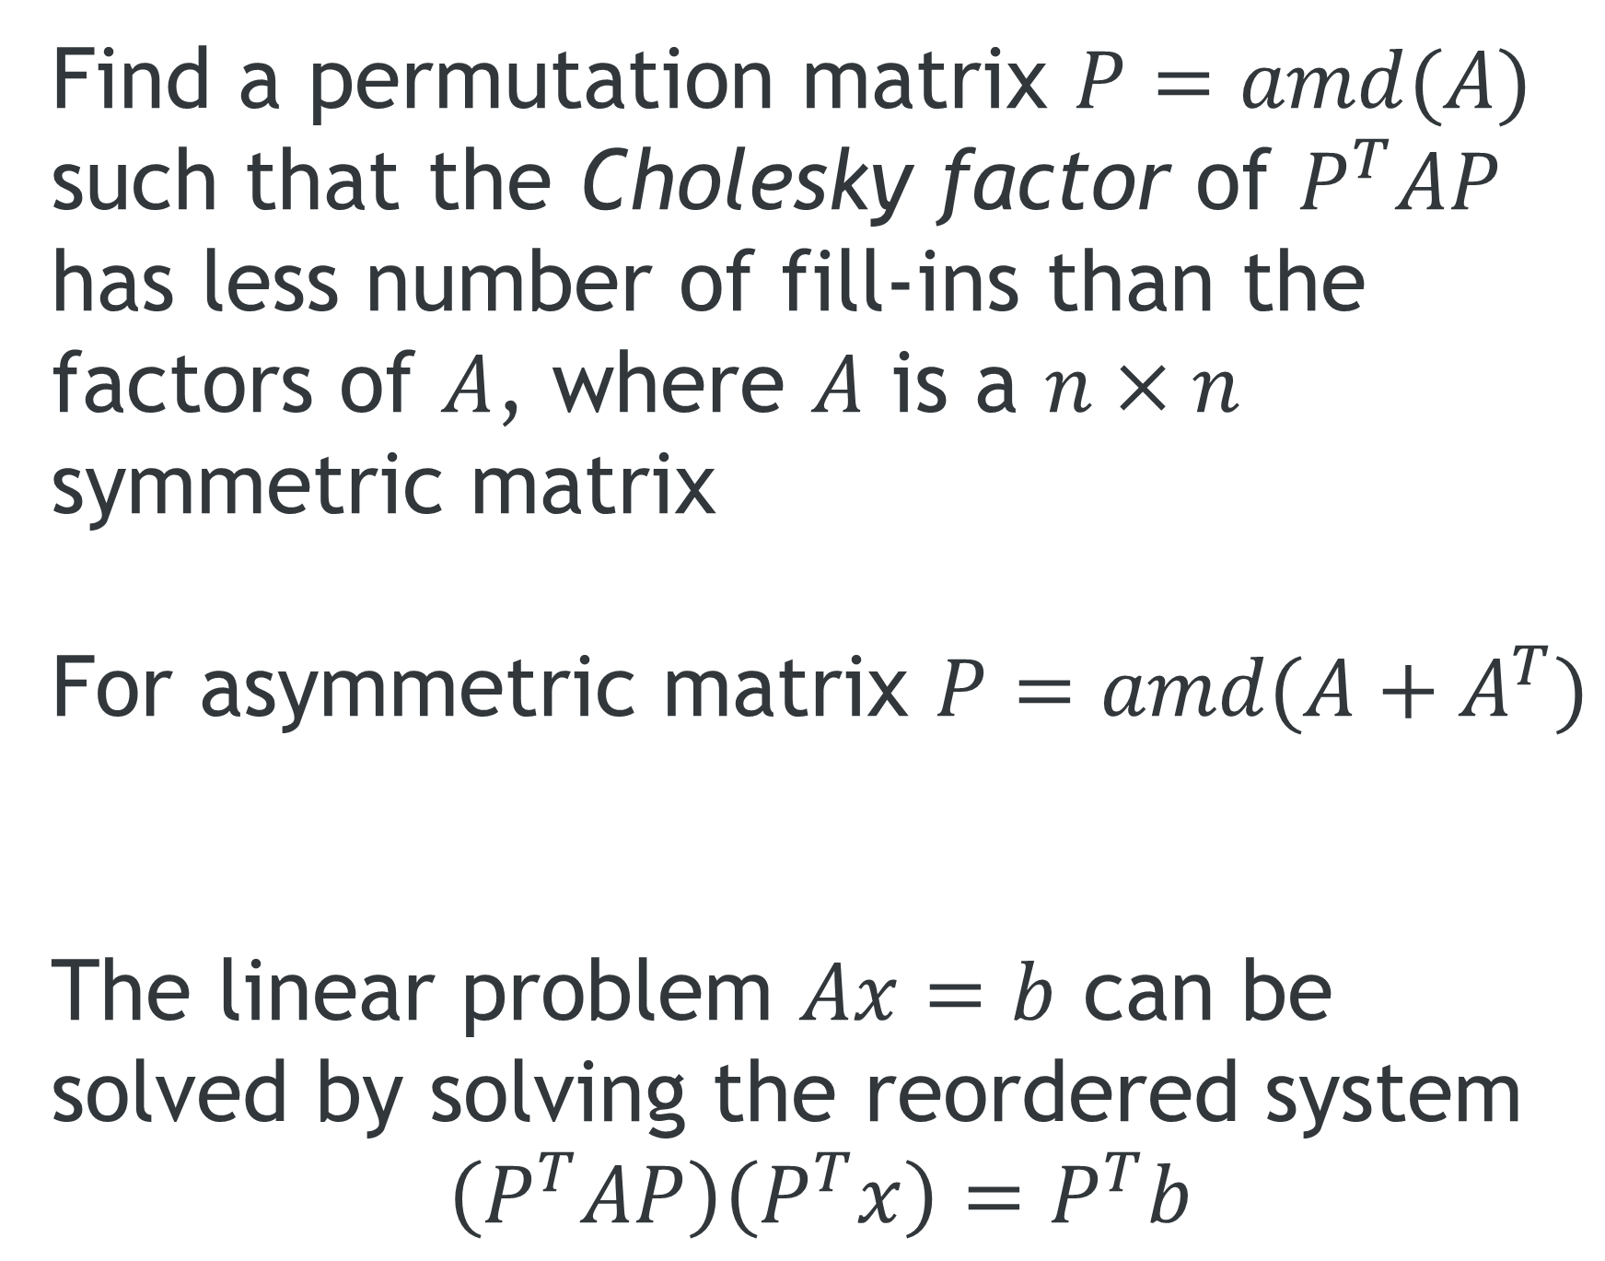
Approximate Minimum Degree Ordering
Pre-Processing
Find a permutation matrix $P=amd(A)$ such that the Cholesky factor of $P^{T}AP$ has less number of fill-ins than the factors of $A$, where $A$ is a $n×n$ symmetric matrix
For asymmetric matrix $P=amd(A+A^{T})$
The linear problem $Ax=b$ can be solved by solving the reordered system
$$\left(P^{T}AP\right)\left(P^{T}x\right)=P^{T}b$$

Slide 6
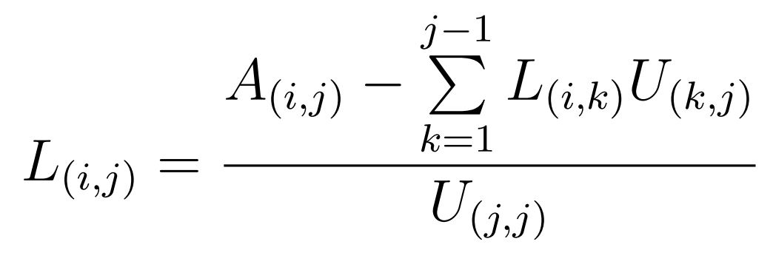
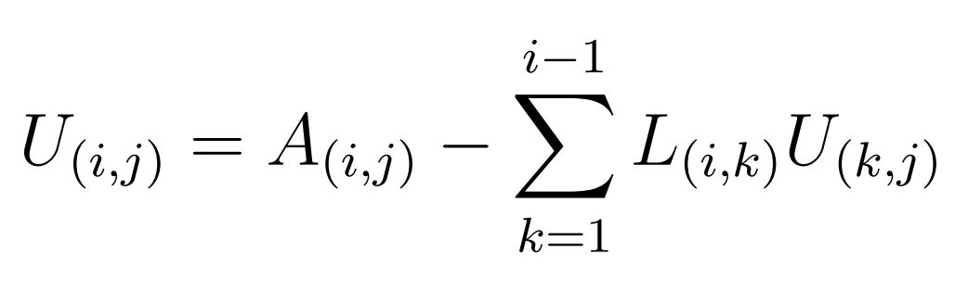
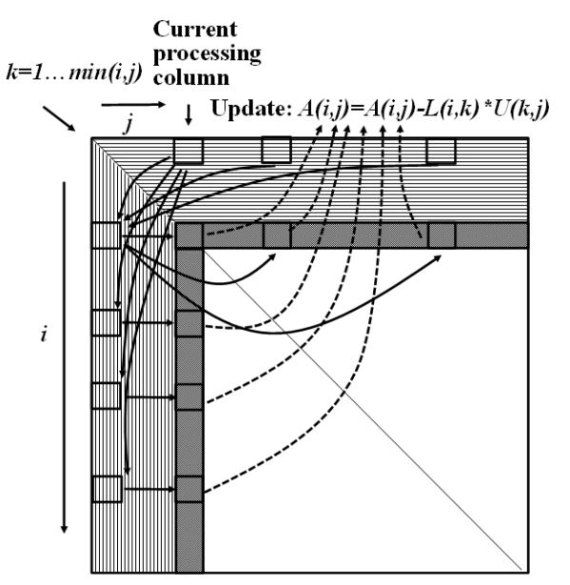
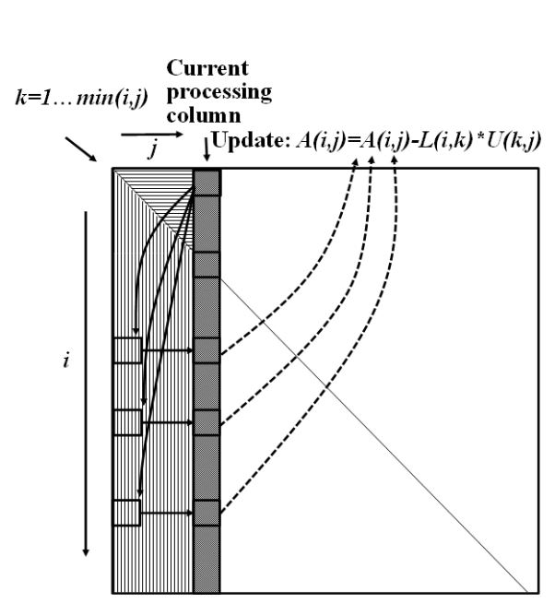
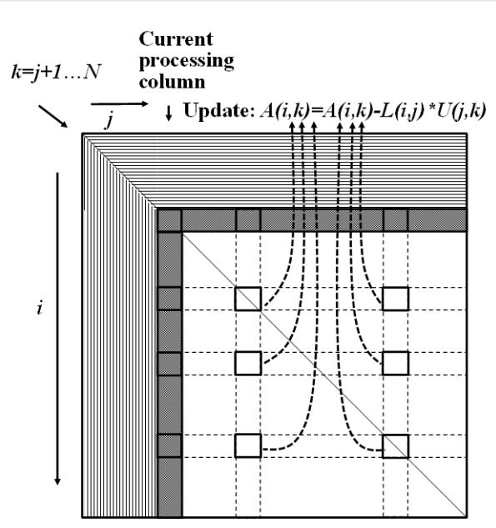
Symbolic Analysis
Crout’s
Left-Looking
Right-Looking

Slide 7
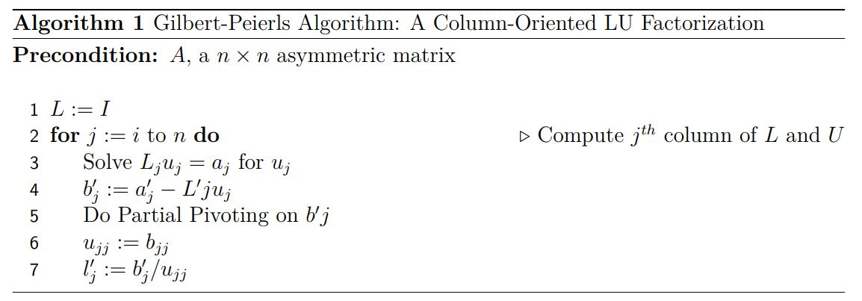
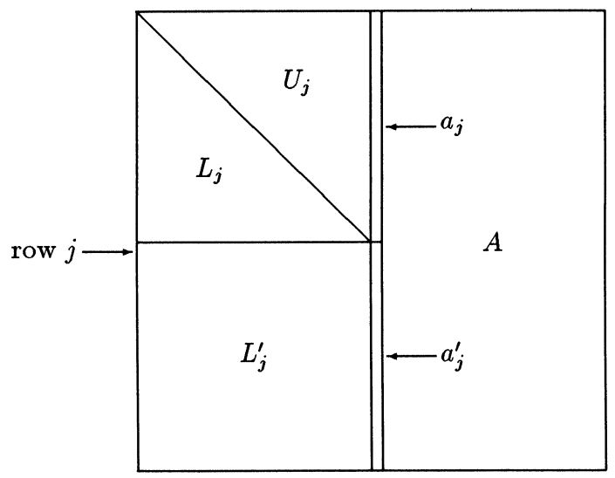
Gilbert-Peierls’ Algorithm
Symbolic Analysis
J. Gilbert and T. Peierls, “Sparse partial pivoting in time proportional to arithmetic operations,” SIAM Journal on Scientific and Statistical Computing, vol. 9, no. 5, pp. 862–874, 1988.

Slide 8
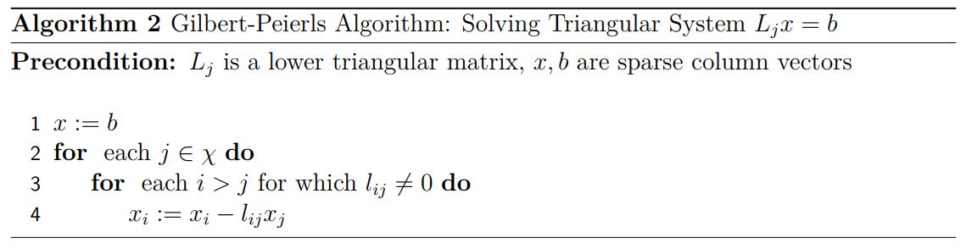
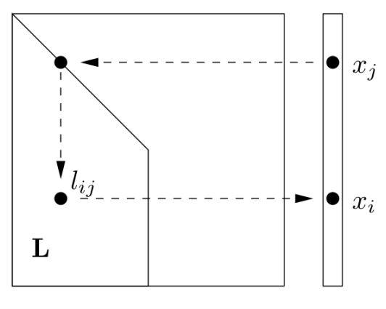
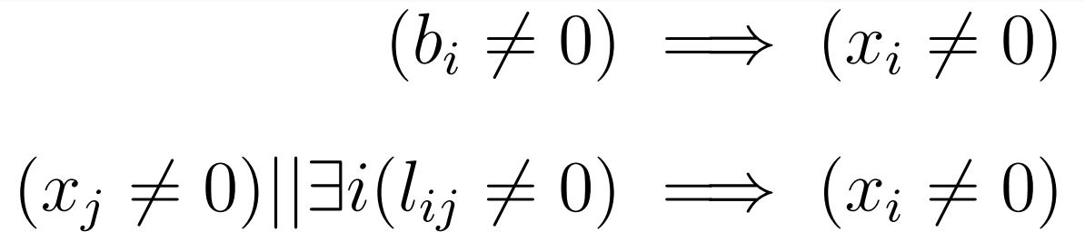
Solving the Lower Triangular System
Symbolic Analysis
Gilbert-Peierls’
T. Nechma and M. Zwolinski, “Parallel sparse matrix solution for circuit simulation on fpgas,” IEEE Transactions on Computers, vol. 64, pp. 1090–1103, April 2015.

Slide 9
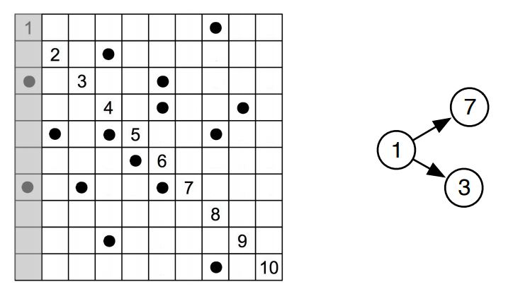



Finding Non-Zero Locations
Symbolic Analysis
Gilbert-Peierls’
Column dependence in the factorization process can be modelled using a DGA of columns.
Computational dependence for $j^{th}$ column is given by $Reach$ of that column in column dependence DAG:
Hence the fill-ins are given by:
T. Nechma and M. Zwolinski, “Parallel sparse matrix solution for circuit simulation on fpgas,” IEEE Transactions on Computers, vol. 64, pp. 1090–1103, April 2015.

Slide 10
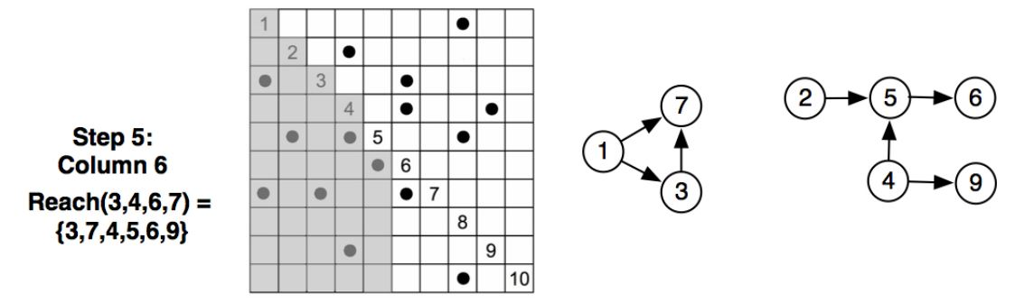
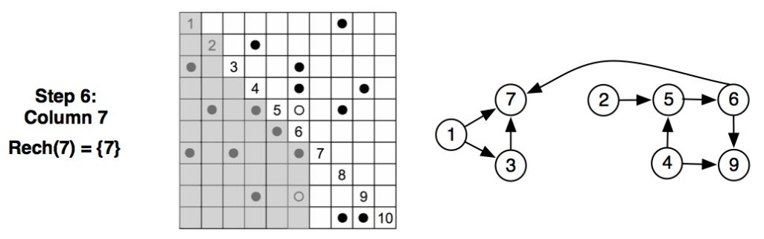
Finding Non-Zero Locations(Example)
Symbolic Analysis
Gilbert-Peierls’

Slide 11
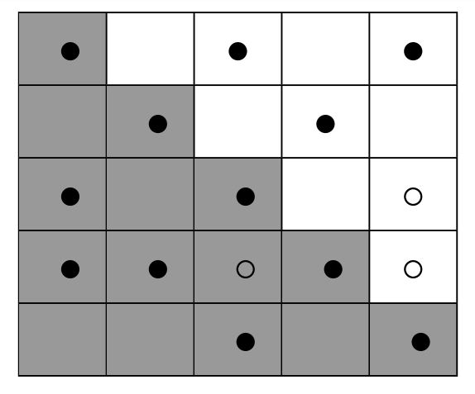
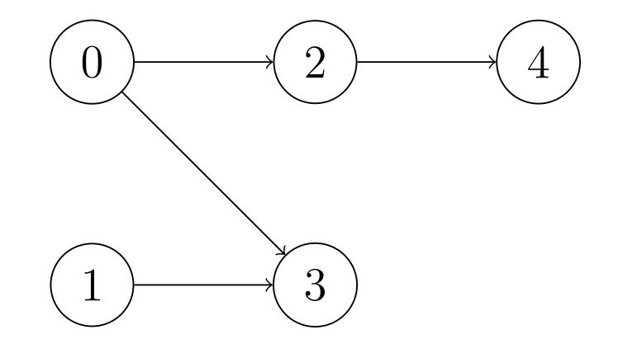
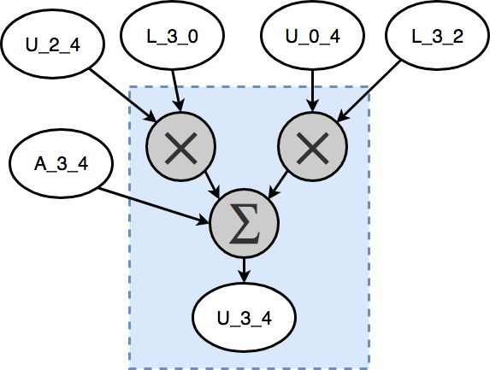
Computation Task Graph
Symbolic Analysis
2
3
4
1
0

Slide 12
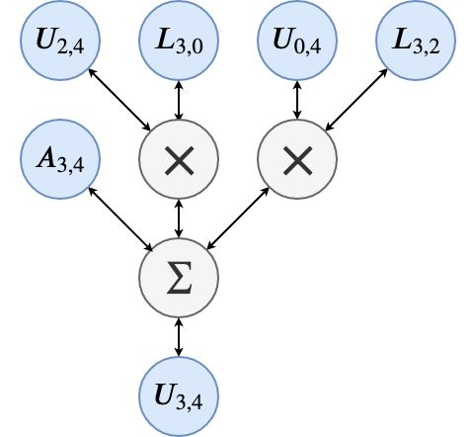
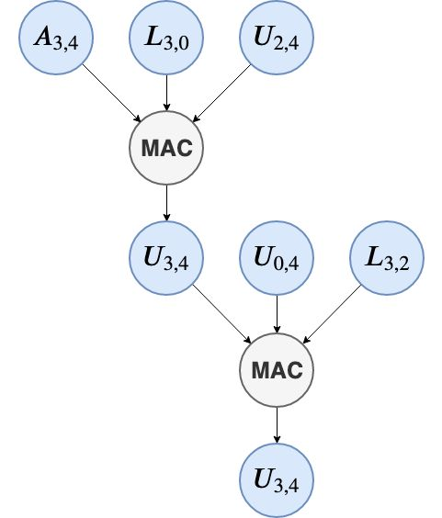
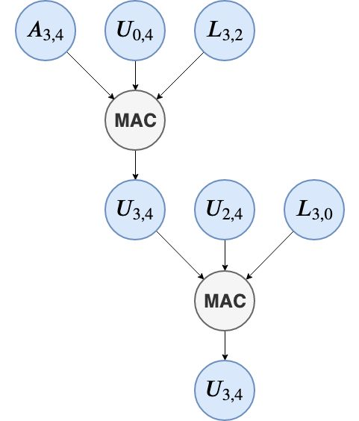

MAC Super Node
Symbolic Analysis
Total n! different execution sequences are possible for computing an element with n pairs of multiplicands
Sequence 1
Sequence 2

Slide 13
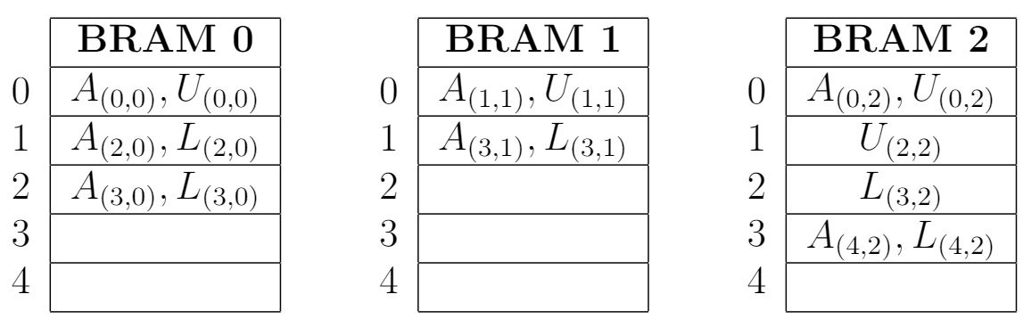
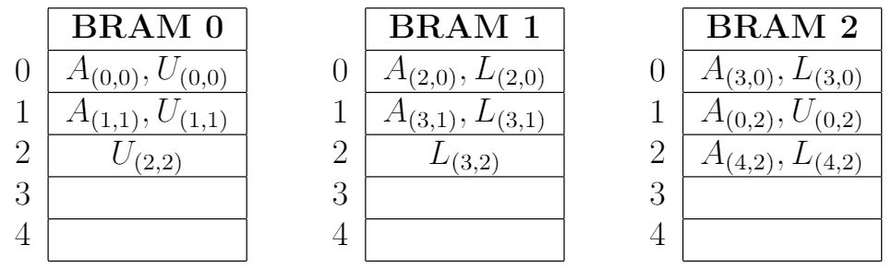
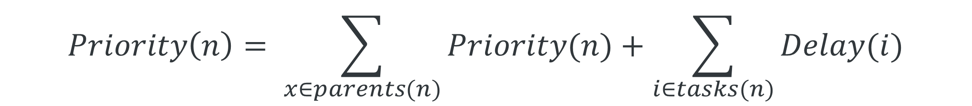
Scheduling
Priority of each node is computed recursively using
$$Priority\left(n\right)= \sum_{x∈parents(n)}{Priority(n)}+\sum_{i∈tasks(n)}{Delay(i)}$$
Priority of the Operations
Column wise Memory Allocation
Memory Allocation Policy
Hardware Architecture
Scheduling Algorithm
Circular Memory Allocation

Slide 14
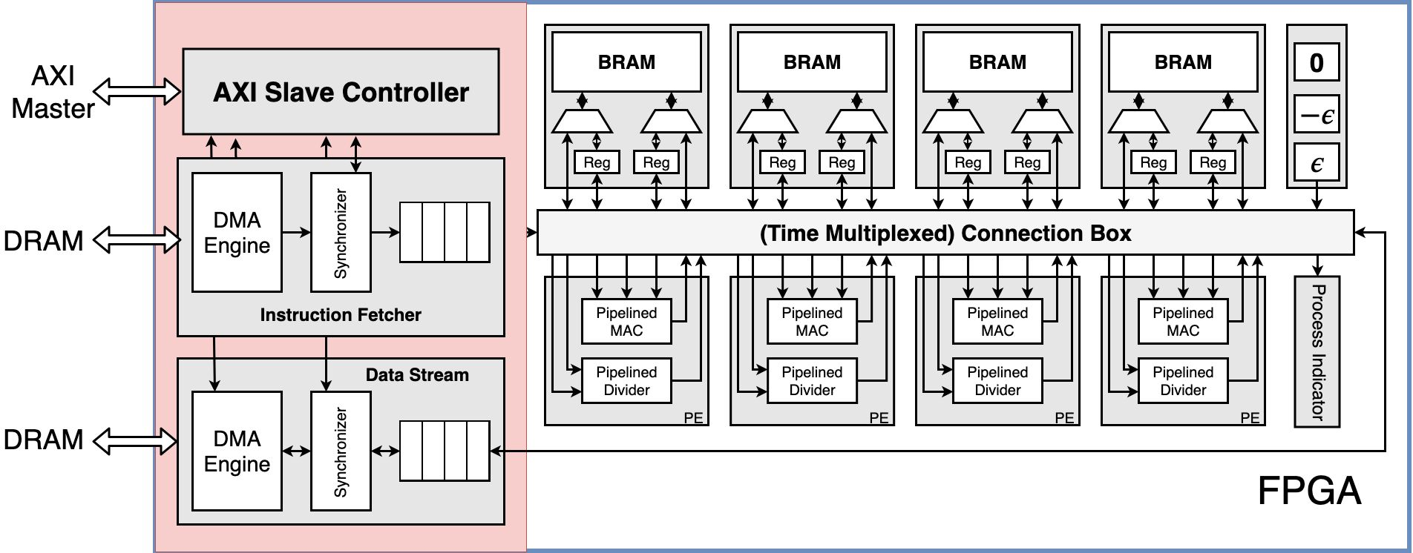
Hardware Architecture

Slide 15
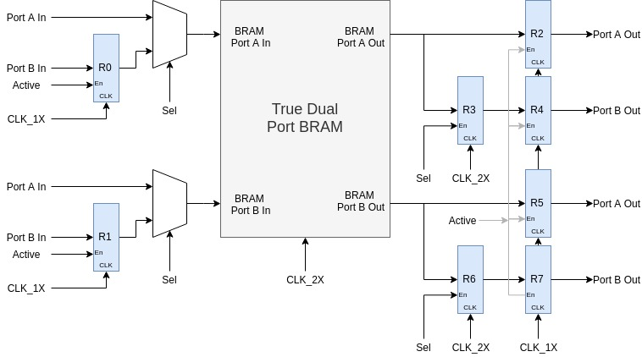
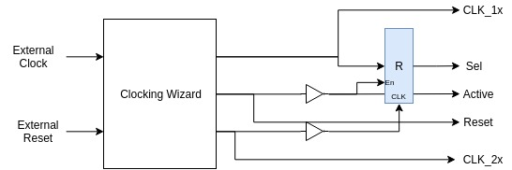
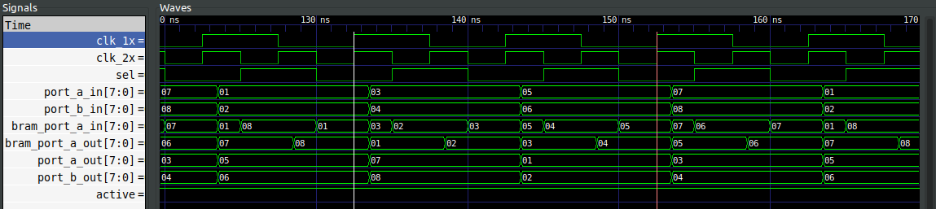
Quad Port BRAM
BRAMs can operate at the clock frequencies up to 400 MHz, which is at least two time faster than the processing elements
Clock and Reset Generation

Slide 16
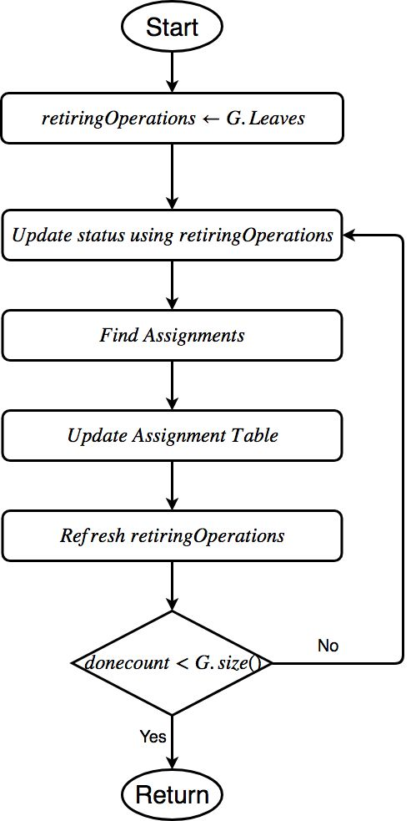
Scheduling
Read latency = 2
Scheduler Table

Slide 17
Scheduling
Finding Assignments

Slide 18
Scheduling
Grouping

Slide 19
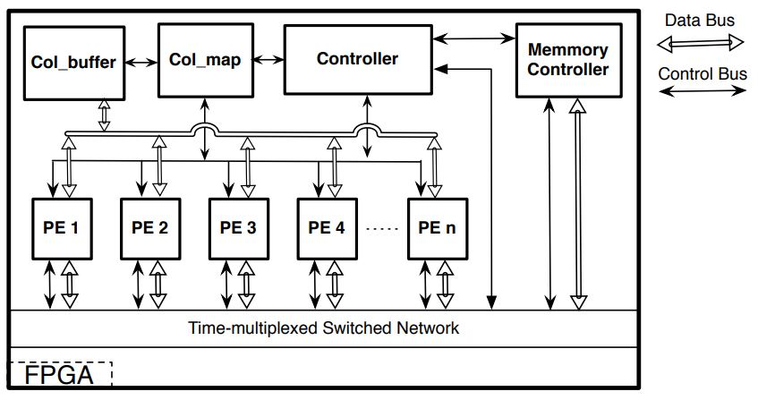
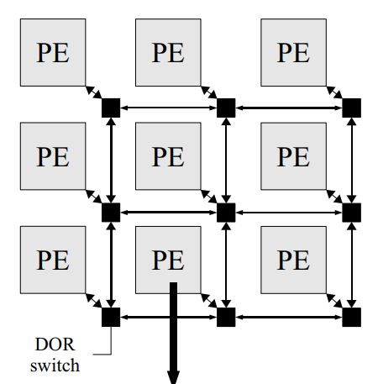
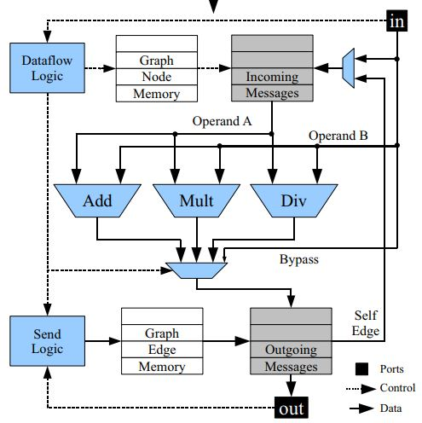
Previous Work
T. Nechma and M. Zwolinski, “Parallel sparse matrix solution for circuit simulation on fpgas,” IEEE Transactions on Computers, vol. 64, pp. 1090–1103, April 2015.
N. Kapre and A. DeHon, “Parallelizing sparse matrix solve for spice circuit simulation using fpgas,” in 2009 International Conference on Field Programmable Technology, pp. 190–198, Dec 2009.

Slide 20
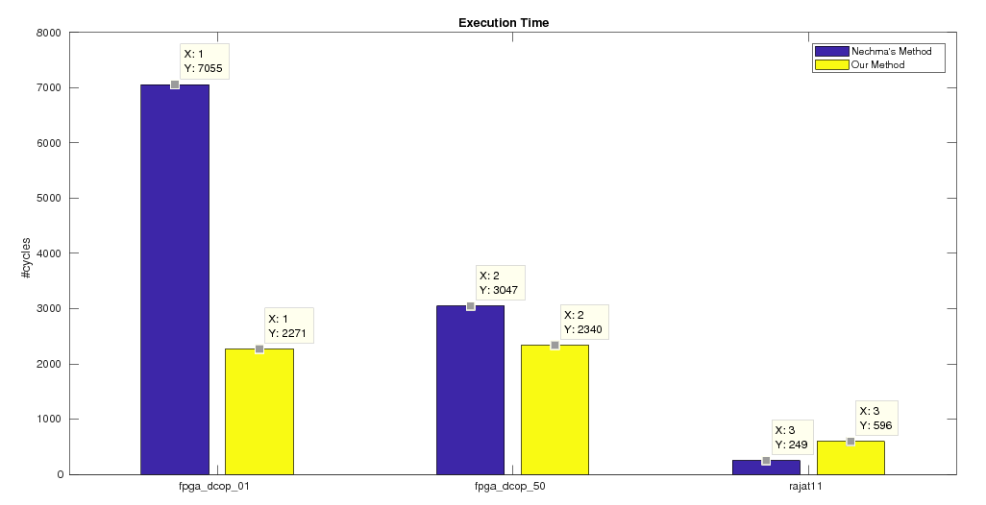
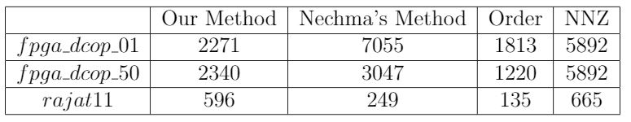
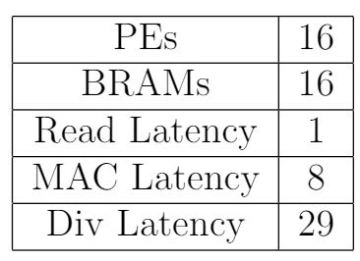
Results

Slide 21
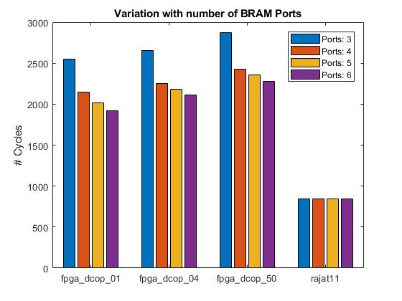
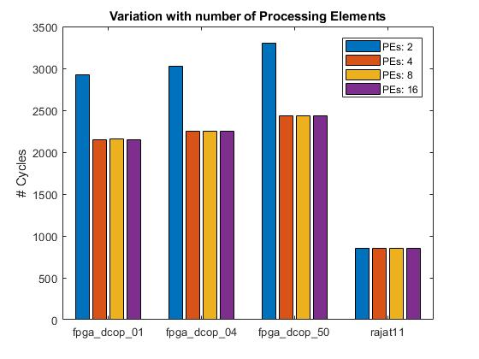
Performance Variation with the Number of Units

Slide 22
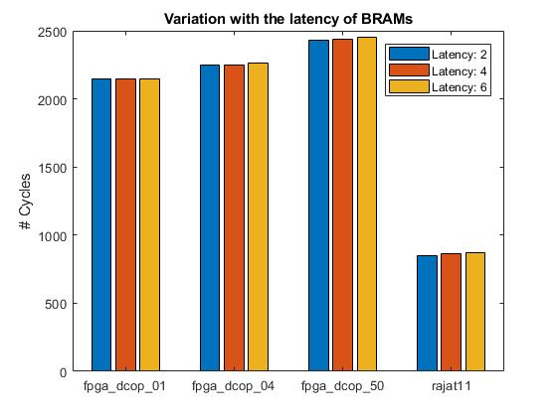
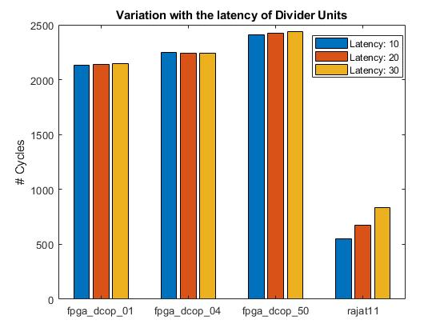
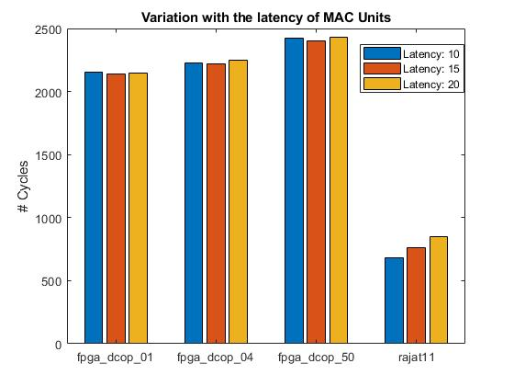
Performance Variation with the Latency of Units

Slide 23
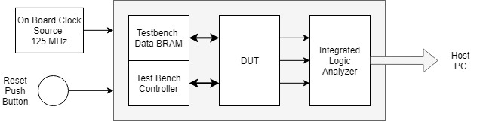
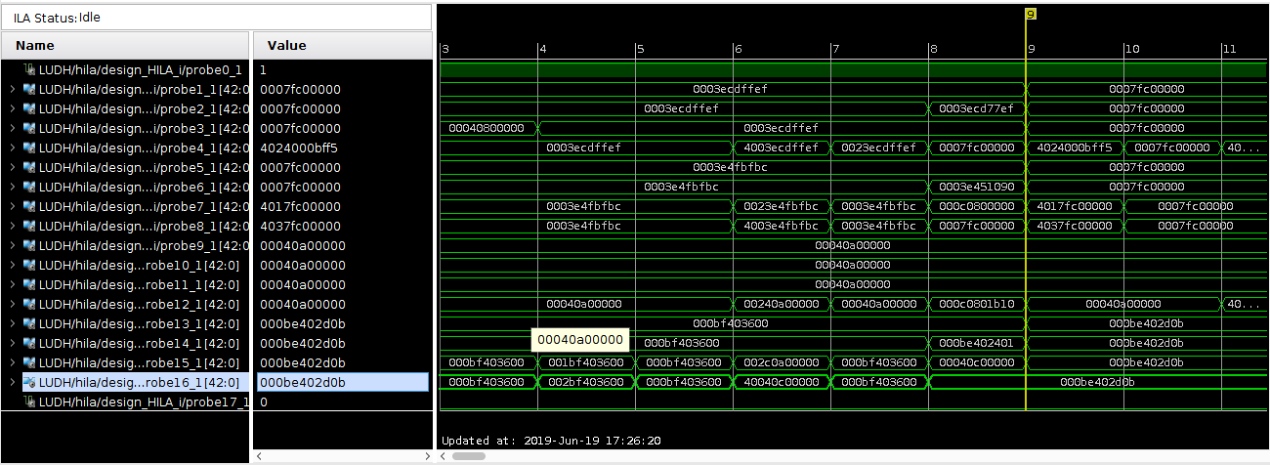
Hardware Testing
ILA ports are connected to the inputs and outputs of the BRAM ports

Slide 24


False Hold Violation
The path between R3 and R4 is not triggered at the rising edge of the CLK_1X hence the hold violation at this edge must be ignored

Slide 25


Future Work
Synthesize BRAM
Integrate with the on-chip ARM core
New scheduling strategies
25

Slide 26
Thank you

Slide 27
Future Work
Synthesize BRAM
Port the tool on for on-chip ARM core
New scheduling strategies

Slide 28
Parallelizing the Sparse LU Decomposition

